Slide 1
Credit Risk Assessment for Loan Approval
Supervised by: Dr.Maggie
Done by:
Ahmed Tarek
Omar Ahmed
Karim Mohamed
Youssef Raafat

Slide 2
When Risk is Ignored, the Costs are Unbearable
2008 Global Financial Crisis:
Root Cause: Financial institutions failed to assess and mitigate risks associated with subprime loans.
Consequences: Over $10 trillion wiped from global markets, millions lost jobs, and trust in financial systems shattered.
“The inability to manage credit risk was one of the largest contributors to the financial crisis of 2008.” — Financial Stability Board

Slide 3
Trust is Expensive, and Risk Mismanagement Burns It
Post-2008 Crisis:
Unchecked defaults create a perception of mismanagement, causing customers to lose confidence.
68% of Americans lost trust in banks, causing withdrawals, reduced borrowing, and shifts to competitors.
Governments introduced stricter rules like Basel III, increasing costs for compliance, staffing, and system upgrades, reducing the profitability and limiting innovation.

Slide 4
Takeaways
Lenders that fail to assess risk face financial losses, reputational damage, and higher regulatory costs.
Trust is essential in the financial industry.
Managing risk responsibly is key to maintaining trust and long-term success.

Slide 5
Solution
Develop Data-Driven Models to assess credit risk that can:
Reduce human error and bias in loan approval.
Provide more accurate assessments of a borrower’s ability to repay.
Streamline the loan approval process, saving time and resources.
Help avoid bad debts and financial crises, especially in the case of unqualified borrowers.

Slide 6
Table of contents
01
02
03
04
Dataset Description
The Approach
Buisness Aspect
Conclusion

Slide 7

01
Dataset Description

Slide 8
Fintech Dataset Overview
The Dataset contains 27030 entries and comes with 24 features.
Customer Details: Includes unique identifiers (Customer Id), Emp. titles , employment length, home ownership status, and annual income (individual/joint).
Loan Information: Covers loan ID, amount, term, interest rate, funded amount, issue date, and type (e.g., Individual, Joint).
Verification & Status: Includes income verification, loan grades (A-G), loan status (e.g., Current, Fully Paid), and payment plan enrollment.

Slide 9
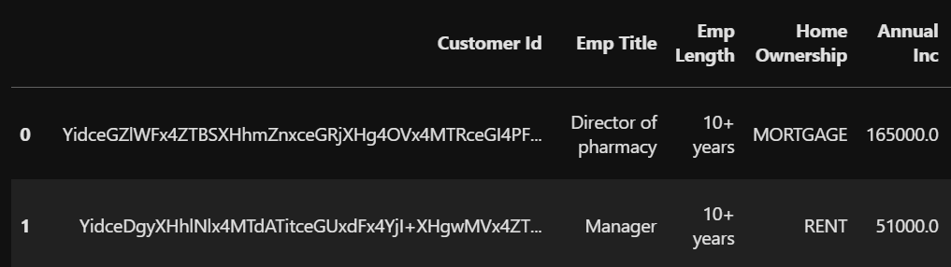
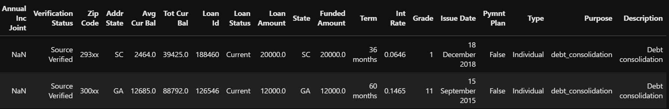
Fintech Dataset Overview
Geographical Data: Includes ZIP codes and state abbreviations for customer residence and loan issuance.
Balances: Provides average and total current balances across customer accounts.
Loan Purpose: Details reasons for loans (e.g., Debt Consolidation, Home Improvement) and borrower-provided descriptions.
Here is a sample from the dataset:

Slide 10
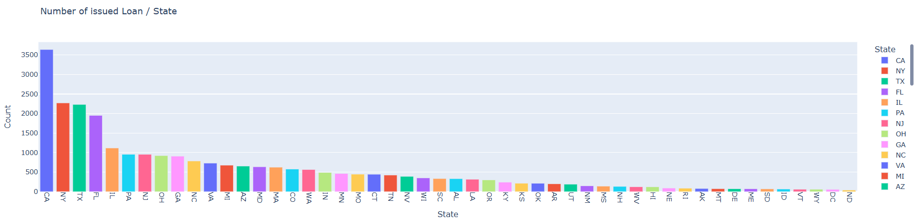
Key findings
we explored different relations between the dataset features
At first, we explored the relation between the state and the no. Loans issued
We found that over 40% of the issued loans are in the top 5 states {CA,NY,TX,FL,IL} where the no. states was 50.

Slide 11
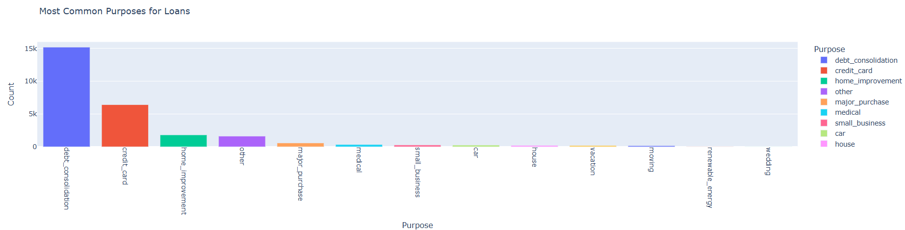
Key findings
We also explored the most common purposes of issuing a loan
We found that over 80% of the issued loans are either for debt consolidation or credit card.

Slide 12
Key findings
We then tried to see if there is a direct relation between previous features and the creditworthiness of a customer (Letter Grade) but graph showed no direct relation between them.
After investigating other features like Loan status, Home ownership and Loan Term, we found some relation between them and Letter Grade feature.

Slide 13
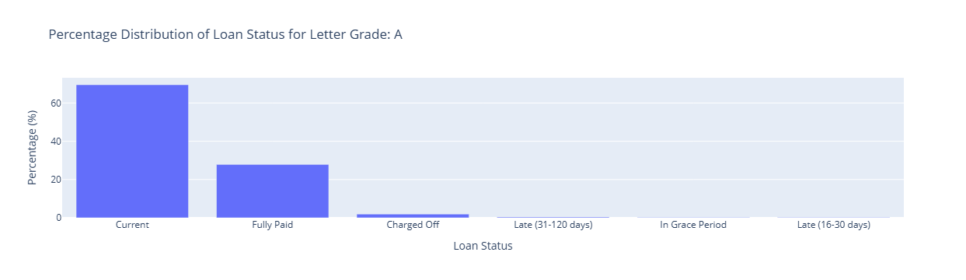
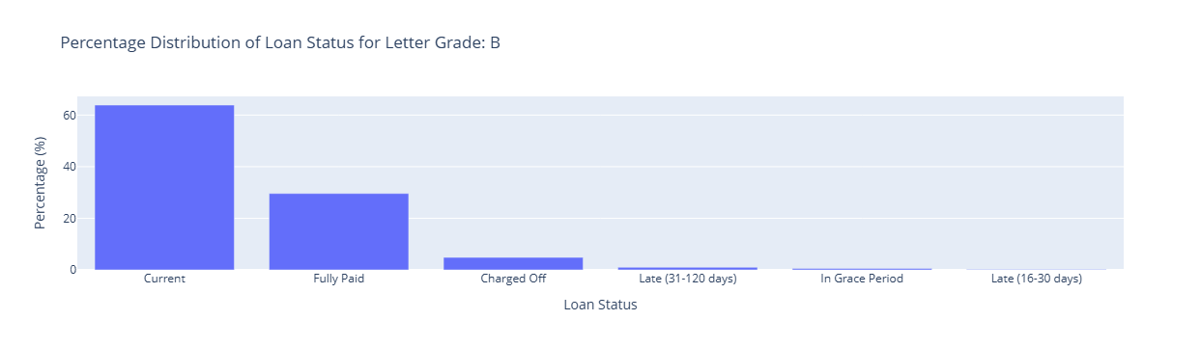
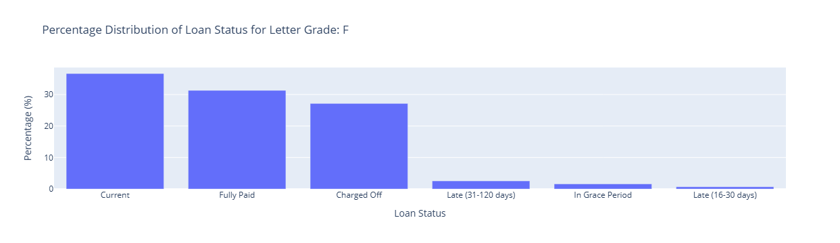
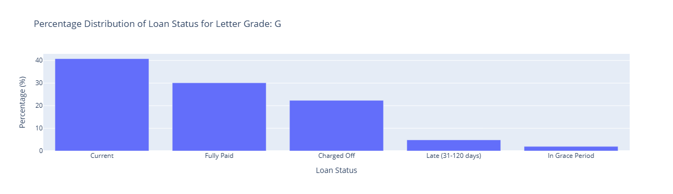
Key findings (Loan status)
As we can see percentages of Current and fully paid Loan decrease as the grade value increase and in turn the
other “bad” statuses begins to appear.

Slide 14
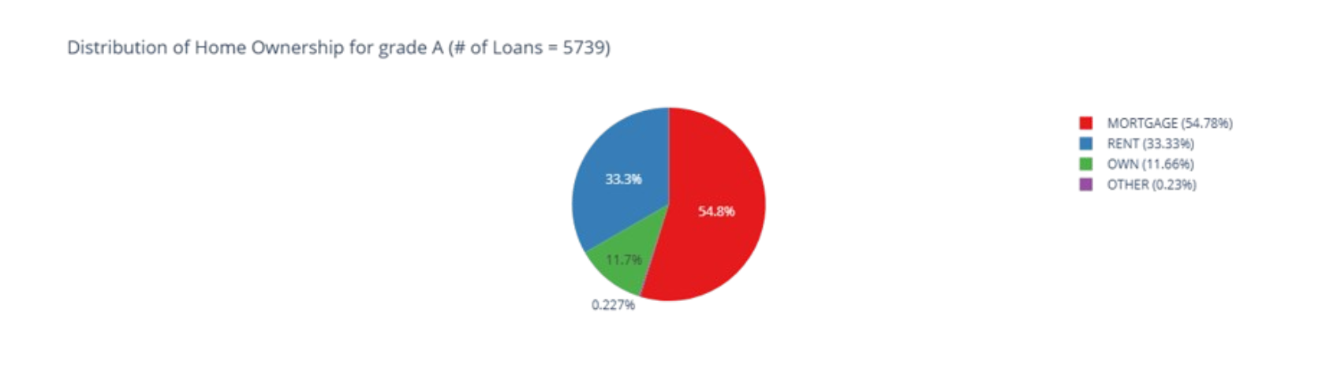
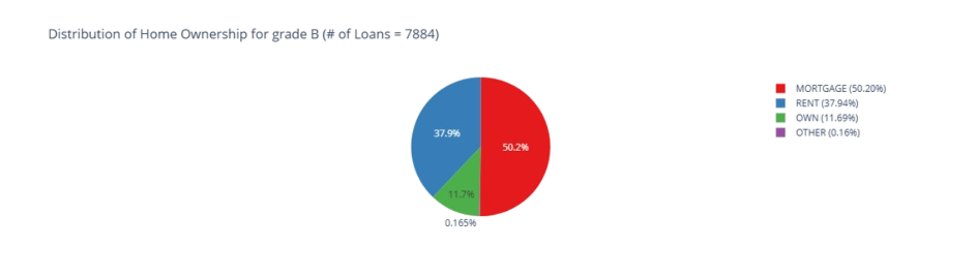
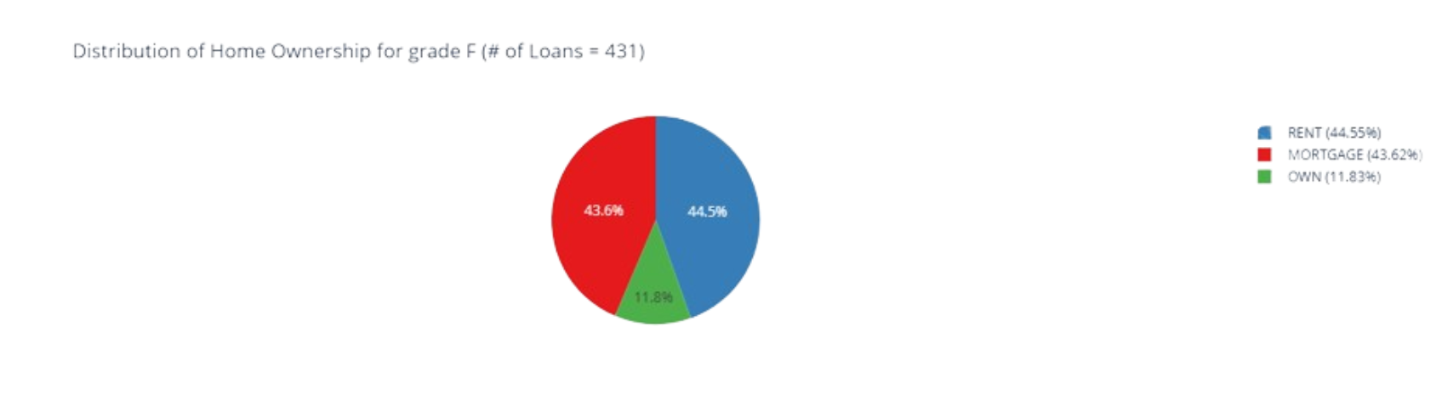
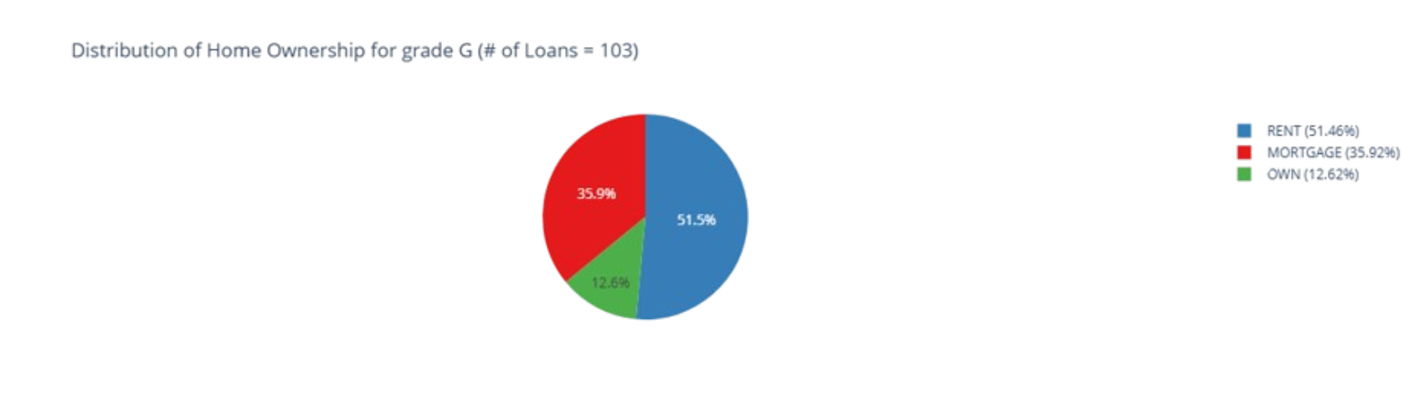
Key findings (Home ownership )
Same effect happened here the percentage of Mortgage decreases as we go down the Grade scale and Rent percentage increases

Slide 15
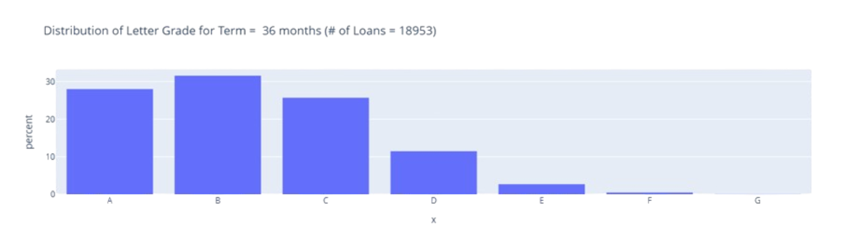
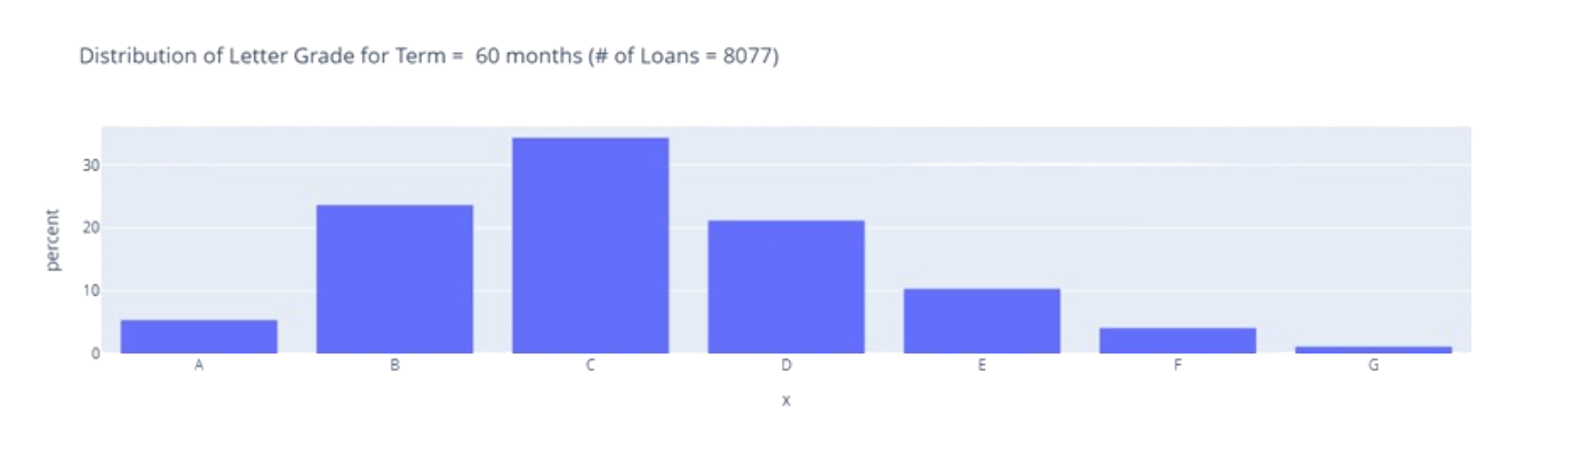
Key findings (Loan Term)
When the Loan Term increase this indicates more risk as the percentage of “bad” grades increase.

Slide 16

02
The Approach

Slide 17

Pipeline
Preprocessing
Simple Cleaning
Handling Inconsistency
Handling Missing
Handling Outliers
Feature Engineering
Dataset
remove extra spaces
Reindexing
Convert to lower/upper case
Inconsistency
Irrelevant data
Imputations
Month number
Letter Grade
Installment per month
Salary Can Cover
Encoding
Customer applying for a loan
End of Preprocessing
Define Rules
Rule Based Model
Rule Based Model
Final Cleaning
Scaling
High risk
Drop Extra columns (e.g. Grade)
low risk
Uncertain
Train
ML Model
ML Model

Slide 18
Rule-Based Layer (First-Pass)
Key Rules Examples:
Employment Title & Length:
If the customer’s EmpLength is > 5 years and EmpTitle includes stable job titles (e.g., “Manager,” “Engineer”), they are flagged with low-risk labels (e.g., A, B).
Employment titles can be identified and grouped into major categories using NLP techniques such as word embeddings, topic modeling, and clustering algorithms.
Home Ownership:
Customers with Home Ownership = Own or Mortgage are considered lower risk compared to Rent.
Reasoning: Owning or mortgaging a home indicates financial responsibility and stability.
Annual Income:
Categorize loans based on loan amounts and interest rates, then identify corresponding annual income ranges for each category to classify them in terms of letter grades.
Reasoning: Higher income generally indicates greater repayment capacity, reducing the likelihood of default.
Each credit grade will have its own set of rules based on attributes such as the ones mentioned above. Each loan will be tested against the rules for each grade, and if it satisfies all the criteria for a specific grade, it will be labeled with that grade. If a loan doesn’t meet the criteria for any grade, it will be passed to the ML layer for further classification.

Slide 19
Machine Learning Layer (Second-Pass)
The machine learning layer handles the uncertain or borderline cases passed from the rule-based system. It uses the dataset to detect complex, non-linear relationships between features and the credit grade.
Steps in the ML Layer:
Feature Selection Examples:
EmpLength, AnnualInc, AnnualIncJoint: Indicators of financial stability.
Tot Cur Bal: Assess financial obligations and capacity to repay.
Purpose: Analyze text data (utilizing NLP techniques) to detect trends in loan purposes.
Home Ownership: Assesses ownership status to infer financial responsibility and risk.
Verification Status: Add weight to verified income and employment.
Model Training :
Train a multiclass classification model (Random Forest, XGBoost, Neural Networks) to predict the credit grade.
Explainability (Optional):
Use tools like SHAP (SHapley Additive exPlanations) to explain feature importance for each prediction.
Example: Grade F was assigned due to Renting, unverified employment, and unstable job title .

Slide 20

03
Business Aspect

Slide 21
Business Strategy
Potential Users
Banks and Credit Unions:
Automate grading customers to streamline loan approvals.
Use rules for simple profiles and models for complex profiles.
Fintech Startups:
Implement as part of credit risk management solutions for small-to-medium businesses.

Slide 22
Business Strategy
Value Proposition
Efficiency:
Rules handle simple cases quickly, while ML focuses on complex ones.
Transparency:
Clear explanations for rule-based decisions; interpretable ML outputs for complex cases.
Scalability:
Easy to scale by adding new rules or retraining the model with more data.
Cost-Effectiveness:
Reduces manual reviews for straightforward cases, lowering operational costs.

Slide 23
Business Strategy
Scalability
Rule Updates:
Easily modify rules based on regulatory changes or new business insights.
Model Retraining:
Retrain the ML model periodically with updated data.
Cloud Deployment:
Deploy the system on cloud platforms to handle high volumes.

Slide 24
04
Conclusion

Slide 25
Conclusion
Problem
Solution
Approach
Loans Approvals Risks
Assessing Loans Risks
Rule-Based + ML Model for Labeling Loan Credit Grades

Slide 26
Thanks
Do you have any questions?

